Slide 1
Wake Panel Method
Kat Hernandez
May 1, 2014
MAE 6226 Final Project

Slide 2
Different Techniques
Spatial wake relaxation
Time stepping method

Slide 3
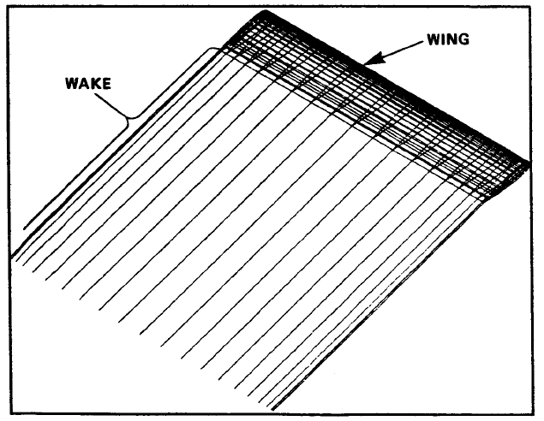
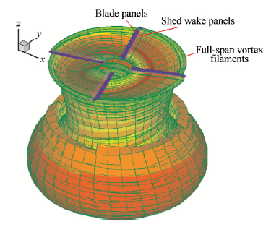
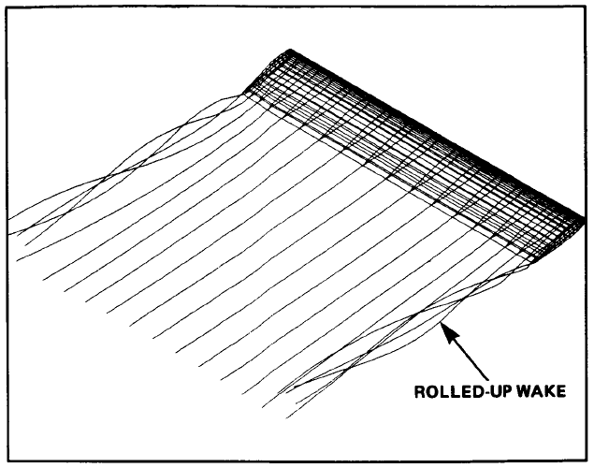
Applications
Wake panels prior to wake relaxation (Smith 1987)
Rotor Wake (Jianfeng 2012)
After wake relaxation (Smith 1987)

Slide 4
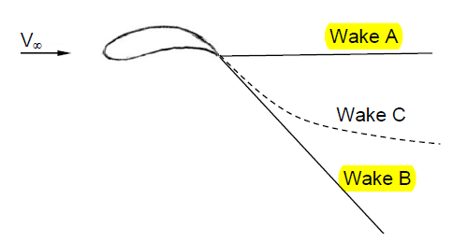
Wake Shapes
(Source: Bramesfield 2006)

Slide 5
Wake Shapes cont..
Wake A: Higher accuracy further downstream
Wake B: Higher accuracy closer to the trailing edge
Wake C: Calculation of induced drag becomes more complicated and conservation of momentum is not always enforced

Slide 6
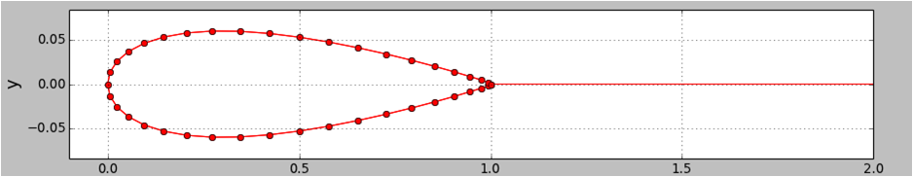
Discretize Geometry
Add wake panel to the definePanels function from lesson 11

Slide 7


Flow Tangency Boundary Condition
Neumman boundary condition
Where,
Type of panels used: Doublet Panels

Slide 8



Doublet Potential

